Slide 1
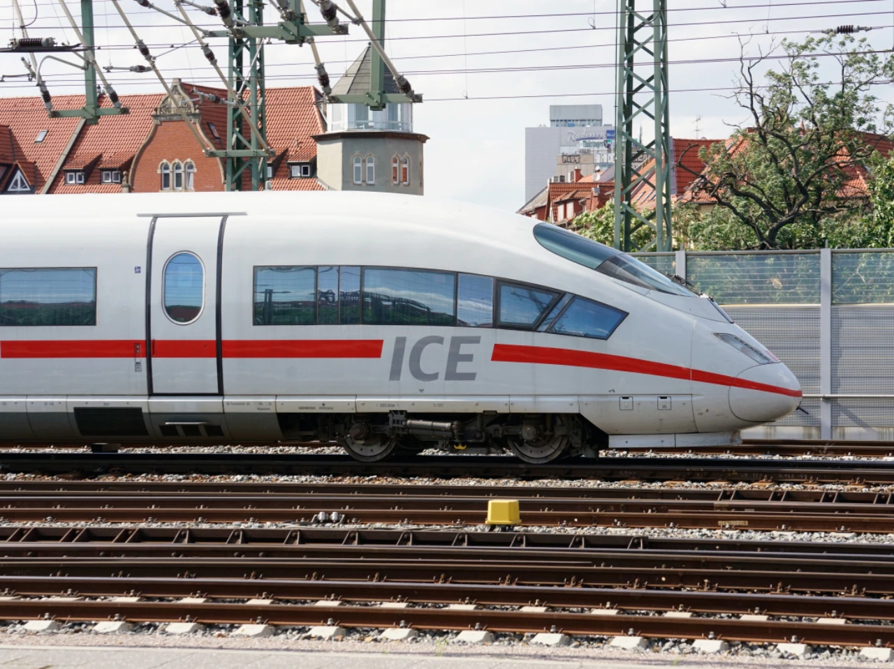

A Presentation by Lu Maywald, Johannes Lauer,
Maje Hansen, Anton Bohlen & Benedikt Gfüllner

Slide 2
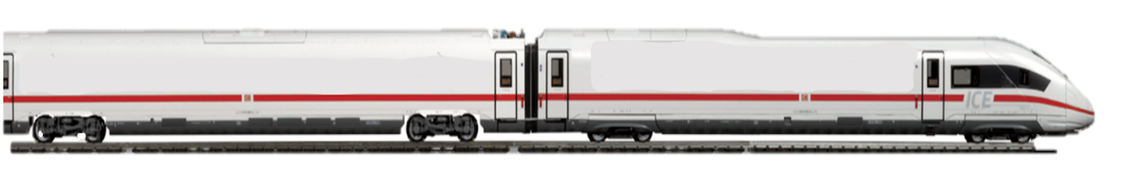
OUTLINE
MACRO PART
Introduction
SWOT
Potters Spider Diagram
Position on the Market
Balance Sheet
MICRO PART
Opportunity 1 - Integral Timetable
Opportunity 2 - Driverless trains
Schedule
Risk & Opportunities
Negotiation
Diffusion & Innovation
Macro Part
Outline
Micro Part

Slide 3
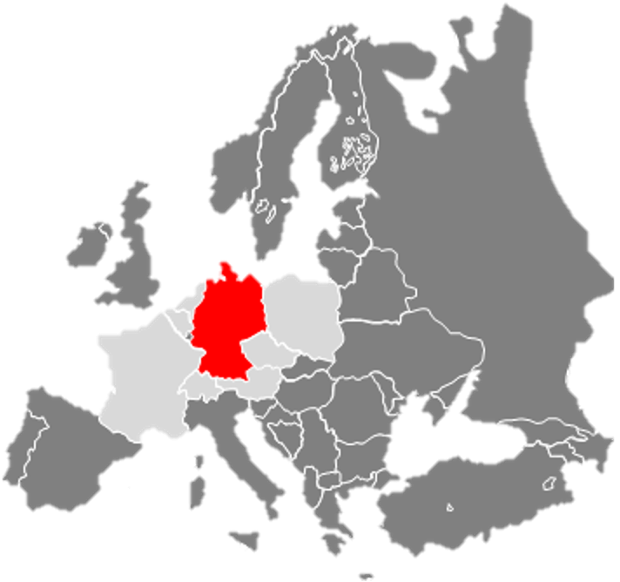
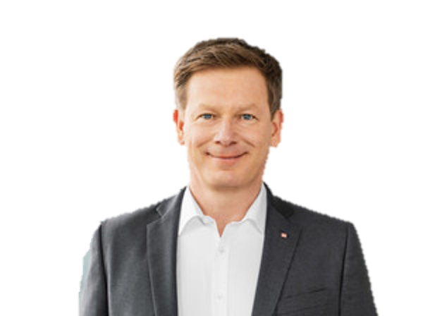
Introduction
WHAT? → Deutsche Bahn (DB) is the largest railroad company in Germany
DB's main activities include:
Passenger transport
Freight trains
Infrastructure
Logistics
Tourism
WHY? → “Germany needs a strong railroad: for the climate, the people, the economy
and for Europe”
WHEN? → founded in 1994 as a successor to the former national railway company of Germany
WHO? → 173,000 people are employed by Deutsche Bahn
→ state-owned company
Dr. Richard Lutz
Chairman and CEO
Macro Part
Introduction
Micro Part

Slide 4
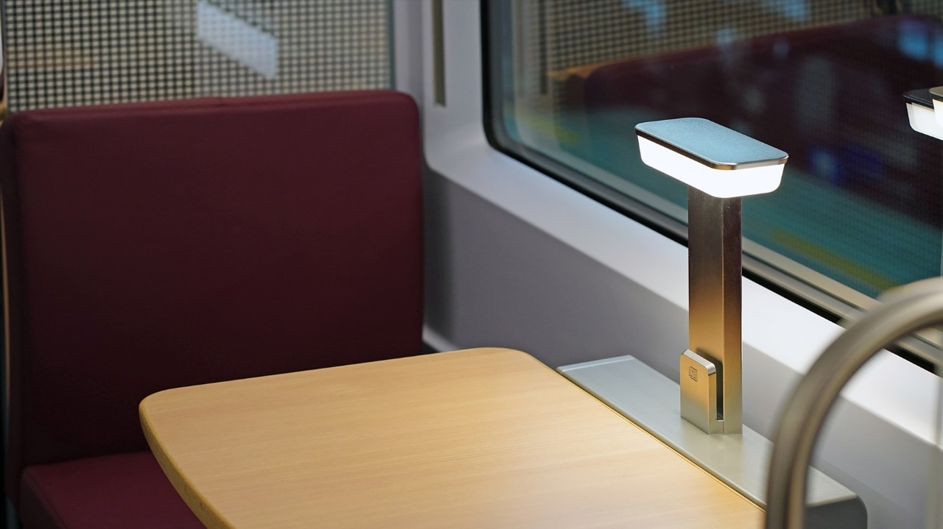
Macro
"The train is the symbol of momentum and progress, it never stops until it reaches its destination."
Macro Part
Micro Part

Slide 5
2. SWOT Analysis
W
S
W
O
T
W
High market power
Diverse product portfolio
Customer services
High Quality Trains
Great mobility network
Sustainable Transport
Freight transport
Delays and cancellations
High price
Overbooked trains
European Railway System
Integral timetable
Digitalisation and Innovation
(AI, driverless trains)
Increasing demand (Climate Change)
Increasing capacity (rails, trains)
Shortage of skilled workers
Competitors (FlixTrain, FlixBus, Ryanair)
Rising energy prices
Political and economic instability
Macro Part
2. SWOT Analysis
Micro Part

Slide 6
3. Spider
High speed
Vacation offers
Free access to WIFI
Diverse product portfolio
Luggage transport
High quality trains
Customer Services
Regional train
Travel comfort
Travel assistance for people with reduced mobility
Modern Trains
Family friendly
S-Bahn
Rental cars
Rail ownership
Ownership of the train stations
Green energy use
Sustainable transport
ICE
Freight transport
High market power
Great mobility network
International network
Carbon neutrality
Macro Part
Spider Map
Micro Part
Macro Part
3. Potters Spider Diagram
Micro Part
Notes:
Just change if the response are not so good @anton

Slide 7
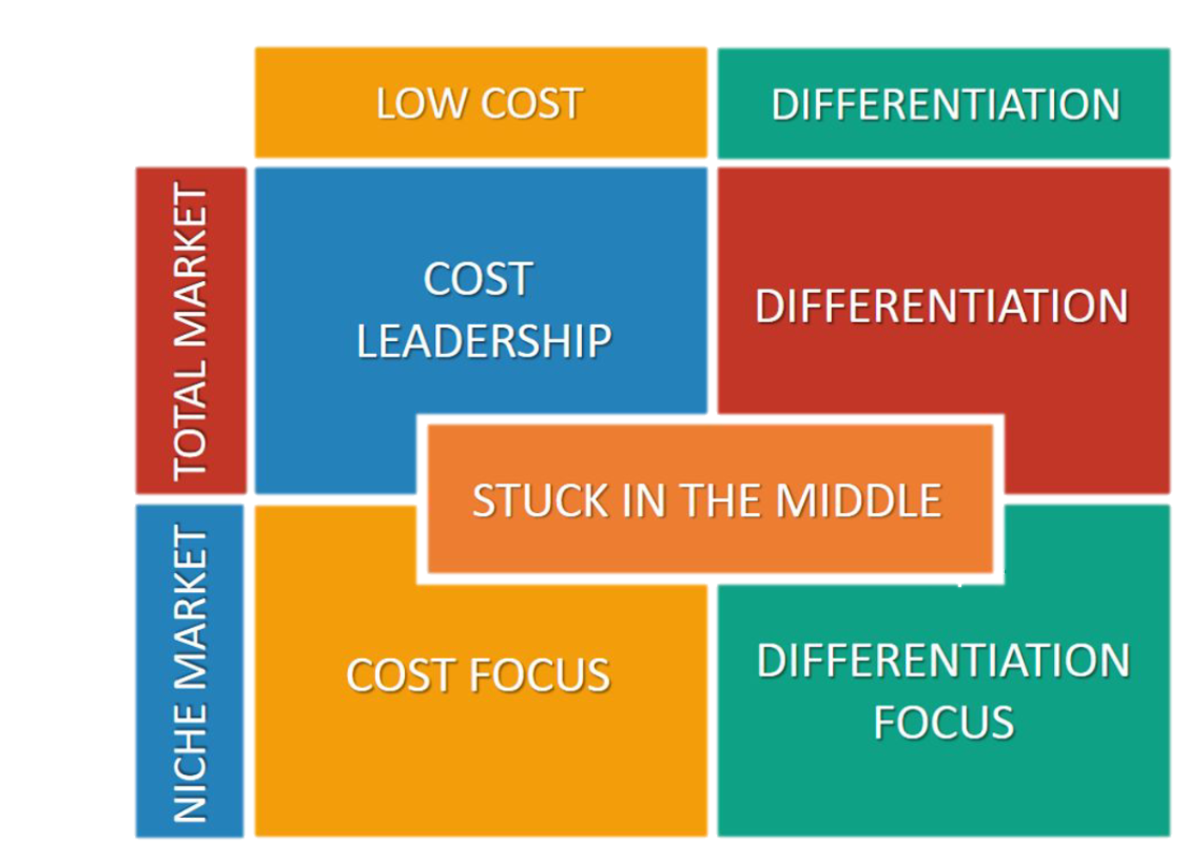

4. Position of Deutsche Bahn
Competitive Advantage
Scope
Macro Part
4. Position of DB
Micro Part
Notes:
Competetive Advantage: no super budget and superpremium but offers everything in the middle (supersparpreis - first class)
Competitors not only Railcompanies but also other means of transport like Flixbus, Airlines

Slide 8



4. Position of Deutsche Bahn
Competitive Advantage
Scope
Macro Part
4. Position of DB
Micro Part
Notes:
Competetive Advantage: no super budget and superpremium but offers everything in the middle (supersparpreis - first class)
Competitors not only Railcompanies but also other means of transport like Flixbus, Airlines

Slide 9
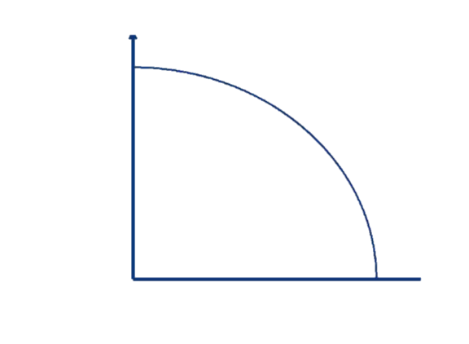
4. Position of Deutsche Bahn
high
WTP
low
high
low
relative cost position
Macro Part
4. Position of DB
Micro Part
Notes:
not on the productivity frontier because not 100% efficient

Slide 10
5. Deutsche Bahn Income statement
(January - June 2022)
Revenue | Passenger transport Cargo other Total Revenue | 8,778 16,793 4,108 29,679
Expenses | Personnel expenses Cost of material others Total Expenses | 10,029 16,502 2,343 28,874
Gains | Inventory changes | 1,923
Losses | Depreciation and interest | 2,130
Net Income | (Revenue+Gains) - Expenses+Losses) | 598
Macro Part
5. Balance Sheet
Micro Part

Slide 11
5. Income Statement for January to June 2022
 | 2022 | 2070 pessimistic | 2070 neutral | 2070 optimistic
Revenue Passenger transport Freight other opportunity 1 opportunity 2 Total Revenue | 8,778 16,793 4,108 . 29,679 | 26,334 39,884 9,757 (5,486) . 75,975 | 32,918 41,983 10,270 (10,973) . 85,171 | 43,890 46,181 11,297 (19,751) . 101,368
Gains Inventory changes | 1,923 | 4,567 | 4,807 | 5,288
Macro Part
5. Balance Sheet
Micro Part

Slide 12
Expenses Personnel expenses Cost of material others opportunity 1 opportunity 2 Total Expenses | 10,029 16,502 2,343 . 28,874 | 22,073 45,381 6,443 ( -2,508) 73,897 | 17,551 41,255 5,858 ( -7,522) 64,664 | 12,536 37,130 5,272 (-12,536) 54,938
Losses Depreciation and interest | 2,130 | 5,858 | 5,325 | 4,793
Net Income (Revenue+Gains) - Expenses+Losses) | 598 | 1,027 | 19,989 | 46,925
ROI | 0.8% | 0,2% | 5,6% | 14,5%
Macro Part
5. Balance Sheet
Micro Part

Slide 13
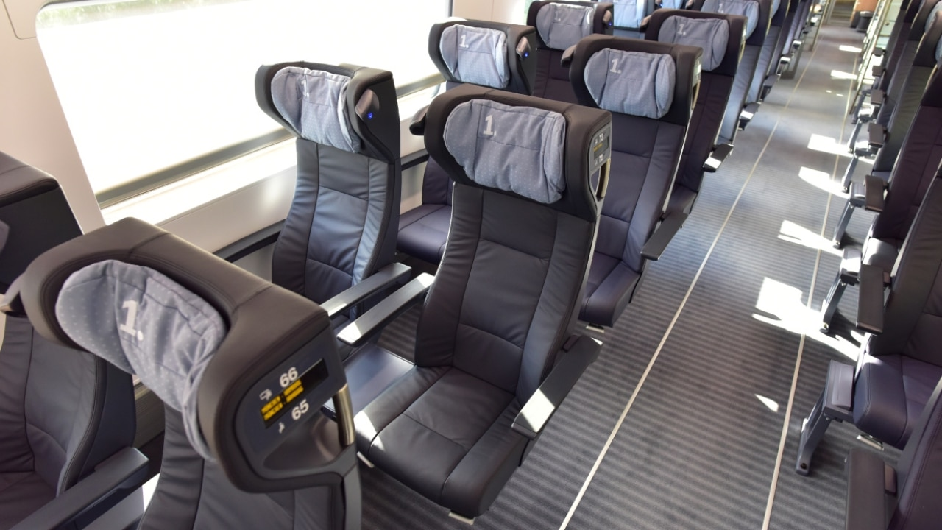
Micro
"Train travel - where punctuality is always on track"
Macro Part
Micro Part

Slide 14
Opportunity 1: Integral Timetable
Objective: Germany-wide coordinated standardized timetable
Can increase the punctuality and has the potential to double the passenger capacity
Macro Part
Micro Part
Opportunity 1

Slide 15
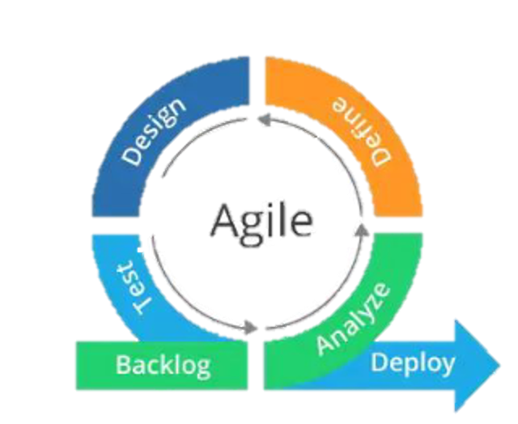
6. Opportunity 1: Integral Timetable
cost estimation: 60-70 Billion €
Schedule: planned until 2030- 2070
Release plan: gradual implementation
already locally implemented
Macro Part
Micro Part
6. Opportunity 1
Notes:
-agile because it is a mainly organizational innovation and it is very important to communicate with all involved parties

Slide 16
6. Opportunity 1: Integral Timetable
 | now | 2025 | 2030 | 2035 | 2040 | 2045 | 2050 | 2055 | 2060 | 2065 | 2070
Pilot projects
railway traffic forecast
Create timetable
Pass necessary legislation and plan infrastructure
Construction
Macro Part
Micro Part
6. Opportunity 1
Notes:
-agile because it is a mainly organizational innovation and it is very important to communicate with all involved parties

Slide 17
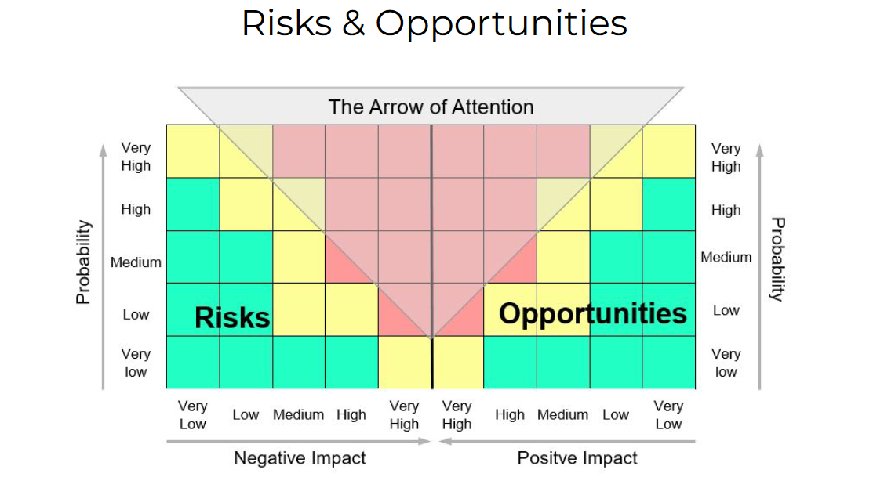
6. Opportunity 1: Integral Timetable
Change in political priorities delays the project
More delays due to climate change
Technological innovation improves the train
Disruptive transport innovation
Pandemic restrictions
2
3
1
5
4
Macro Part
Micro Part
6. Opportunity 1

Slide 18
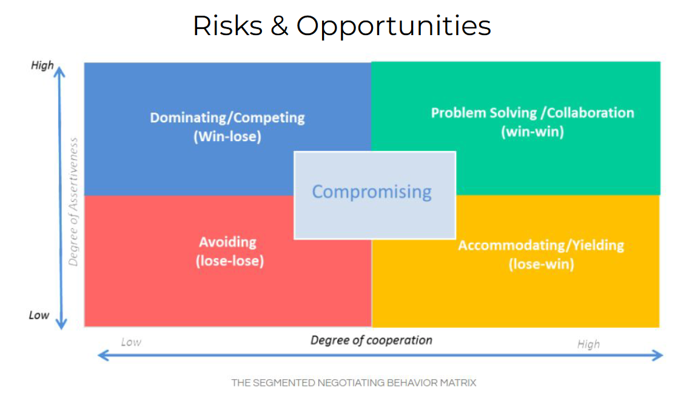
Macro Part
Micro Part
6. Opportunity 1

Slide 19
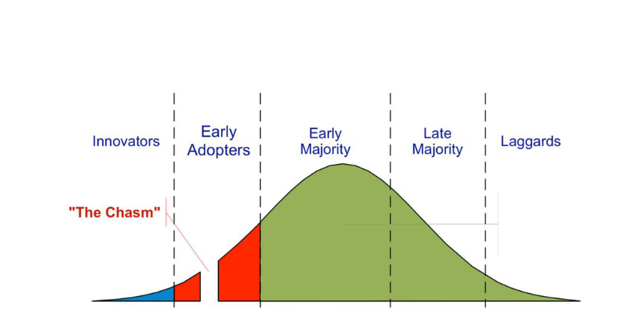
6. Integral Timetable: Diffusion and Innovation
Macro Part
Micro Part
6. Opportunity 1
Notes:
-agile because it is a mainly organizational innovation and it is very important to communicate with all involved parties

Slide 20
7. Opportunity 2: Driverless trains
Objective: Make trains run without a driver
Might increase efficiency through saving personnel cost and minimizing human error while fighting the problem of personnel shortage
Macro Part
Micro Part
7. Opportunity 2

Slide 21
7. Opportunity 2: Driverless trains
costs: Billions of € (Japan: 18 billion US$, EU: 5-10 million € per kilometer)
Schedule: tested already on selected subway trains
Method: waterfall
Release plan: gradual implementation on more and more local short-distance connections before large-scale implementation on long-distance trains as well
Macro Part
Micro Part
7. Opportunity 2
Notes:
Waterfall better method here as this is a step-by-step structural process

Slide 22
8. Driverless trains: Timetable
 | now | 2025 | 2030 | 2040 | 2050 | 2060 | 2070
Conduct research and develop technology
Test technology on short-distance connections
Implement driverless trains in most subways
Implement driverless trains in freight transport
Trains run mainly driverless
Macro Part
Micro Part
8. Schedule
Notes:
Waterfall better method here as this is a step-by-step structural process

Slide 23
9. Risk & Opportunities
Long development process
Low acceptance in population and politics
High negative impact in case of implementing a faulty software
Saving personnel cost and increase efficiency
Increase the percentage of trains being on time
1
4
5
2
3
Macro Part
Micro Part
9. Risk

Slide 24
10. Negotiation
Macro Part
Micro Part
10. Negotiation
Notes:
Would demand high level of cooperation with government institutions, R&D companies and manufacturers.
View point today: assertiveness not to high due to social fears and a high dependence on train drivers, technology not developed enough yet

Slide 25
11. Diffusion and Innovation
Macro Part
Micro Part
11. Diffusion
Notes:
There are already some subway and tram trains in Hamburg for example that drive without a driver, but the project is still very much in the innovation area for most parts

Slide 26
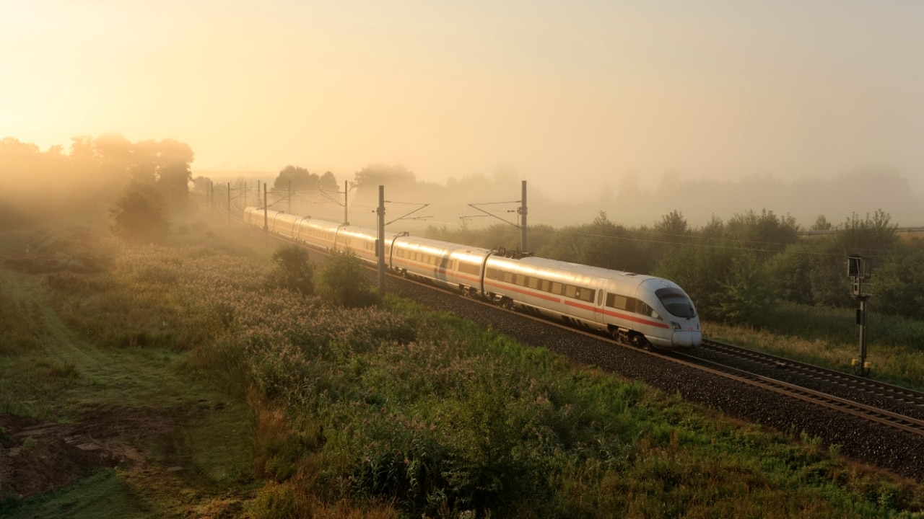
“Thank you for travelling with Deutsche Bahn!”
A Presentation by Lu Maywald, Johannes Lauer,
Maje Hansen, Anton Bohlen & Benedikt Gfüllner

